Slide 1

Movable Road Divider for Organized Vehicular Traffic Control
Under the Guidance of
Mr. P. Bhaskar Rao, Assistant Professor
Department of Computer Science & Engineering
B V Raju Institute of Technology, Narsapur
Presented by
K. V. Pavan Kumar, 16211A05C8
L. A. Radhakrishna Das, 16211A05D3
M. Nikhil Pavan Sai, 16211A05D6

Slide 2
Abstract
Abstract
Introduction
Existing System
Proposed System
Software/Hardware Requirements
References
Road Divider is generically used for dividing the Road for ongoing and incoming traffic.
This helps keeping the flow of traffic efficient manner.
Generally there is equal number of lanes for both ongoing and incoming traffic.

Slide 3
Abstract
Introduction
Existing System
Proposed System
Software/Hardware Requirements
References
Introduction
In any city, there is industrial area or shopping area where the traffic generally flows in one direction in the morning or evening.
The other side of Road divider is mostly either empty or very under utilized.

Slide 4
Abstract
Introduction
Existing System
Proposed System
Software/Hardware Requirements
References
Introduction
This is true for peak morning and evening hours. This results in loss of time for the car owners, traffic jams as well as under utilization of available resources.
An Automated road divider can provide a solution to the above mentioned problem effectively. Here Low, Medium and High density of traffic value will be posted on IOT server as a graph.

Slide 5
Abstract
Introduction
Existing System
Proposed System
Software/Hardware Requirements
References
Introduction
The domain is Embedded Systems.
The controller used is ATMEGA-328 and the crystal is of 16MHz.
We also used DC motor and Ultra Sonic Sensors in our project.

Slide 6
Abstract
Introduction
Existing System
Proposed System
Software/Hardware Requirements
References
Existing System
The problem with Static Road Dividers is that the number of lanes on either side of the road is fixed.
Since the resources are limited and population as well as number of cars per family is increasing, there is significant increase in number of cars on roads. This calls for better utilization of existing resources like number of lanes available.

Slide 7
Abstract
Introduction
Existing System
Proposed System
Software/Hardware Requirements
References
Proposed System
Our aim is to formulate a mechanism of automated road divider that can shift lanes, so that we can have number of lanes in the direction of the rush.
The cumulative impact of the time and fuel that can be saved by adding even one extra lane to the direction of the rush will be significant.

Slide 8
Abstract
Introduction
Existing System
Proposed System
Software/Hardware Requirements
References
Proposed System
With the smarter planet application proposed below, we will also eliminate the dependency on manual intervention and manual traffic coordination so that we can have a smarter traffic all over the city.

Slide 9
Introduction
Existing System
Proposed System
Software Requirements
References
Abstract
Introduction
Existing System
Proposed System
Software Requirements
Architecture Model
Modules
UML Diagrams/ER Diagrams/Flow Charts
References
Software Requirements
Arduino IDE
Embedded C
Microcontroller : Arduino Uno
Wifi-module
Driver circuit
DC motor
LEDs
Ultrasonic sensor

Slide 10
Architectural Model
Block Diagram:
Abstract
Introduction
Existing System
Proposed System
Software Requirements
Architectural Model
Modules
UML Diagrams/ER Diagrams/Flow Charts
References
Power supply
Traffic signals
ATMEGA-328
Ultrasonic Sensor
Buzzer
H-bridge
Road divider motor

Slide 11
Modules
Abstract
Introduction
Existing System
Proposed System
Software Requirements
Architecture Model
Modules
UML Diagrams/ER Diagrams/Flow Charts
References
Ultrasonic sensor
DC motor
Traffic lights
IOT

Slide 12
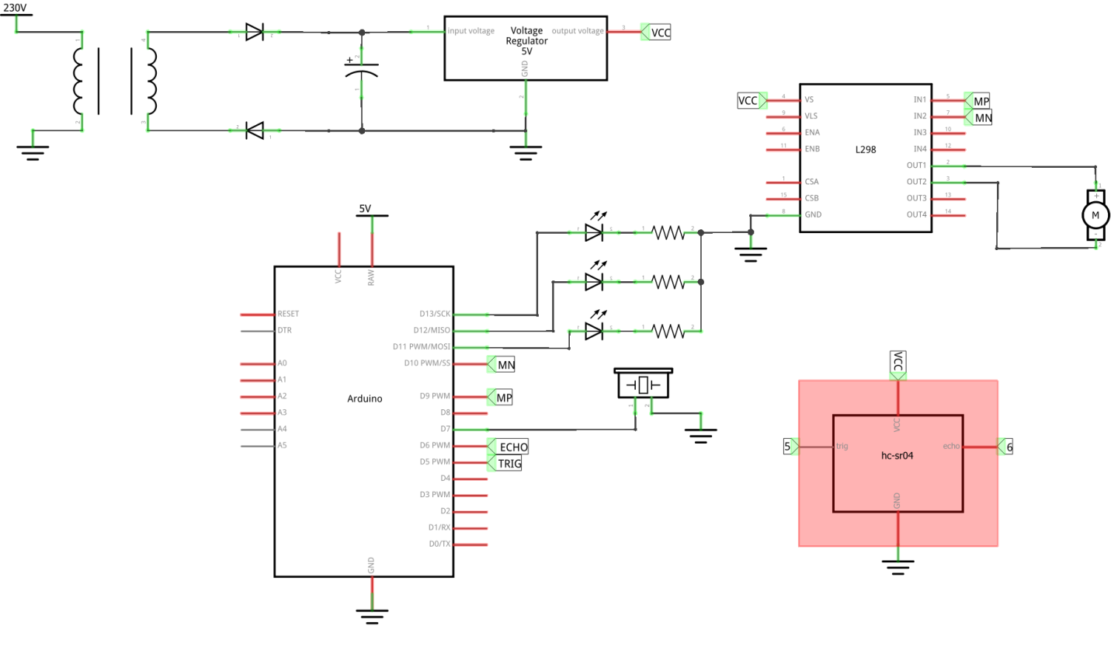
UML Diagrams/ER Diagrams/Flow Charts
Abstract
Introduction
Existing System
Proposed System
Software requirements
Architecture Model
Modules
UML Diagrams/ER Diagrams/Flow Charts
References
SCHEMATIC DIAGRAM:

Slide 13
UML Diagrams/ER Diagrams/Flow Charts
Abstract
Introduction
Existing System
Proposed System
Software requirements
Architecture Model
Modules
UML Diagrams/ER Diagrams/Flow Charts
References
Use case

Slide 14
UML Diagrams/ER Diagrams/Flow Charts
Abstract
Introduction
Existing System
Proposed System
Software requirements
Architecture Model
Modules
UML Diagrams/ER Diagrams/Flow Charts
References
Sequence

Slide 15
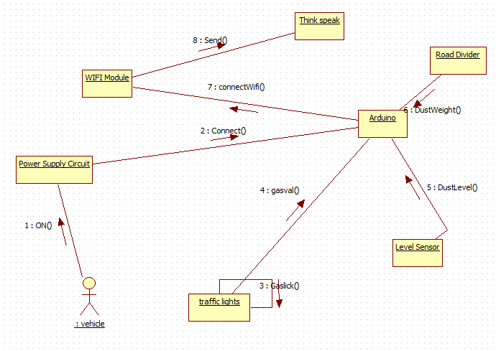
UML Diagrams/ER Diagrams/Flow Charts
Abstract
Introduction
Existing System
Proposed System
Software requirements
Architecture Model
Modules
UML Diagrams/ER Diagrams/Flow Charts
References
Collaboration

Slide 16
UML Diagrams/ER Diagrams/Flow Charts
Abstract
Introduction
Existing System
Proposed System
Software requirements
Architecture Model
Modules
UML Diagrams/ER Diagrams/Flow Charts
References
State Chart

Slide 17
UML Diagrams/ER Diagrams/Flow Charts
Abstract
Introduction
Existing System
Proposed System
Software requirements
Architecture Model
Modules
UML Diagrams/ER Diagrams/Flow Charts
References
Active

Slide 18
UML Diagrams/ER Diagrams/Flow Charts
Abstract
Introduction
Existing System
Proposed System
Software requirements
Architecture Model
Modules
UML Diagrams/ER Diagrams/Flow Charts
References
Component

Slide 19
UML Diagrams/ER Diagrams/Flow Charts
Abstract
Introduction
Existing System
Proposed System
Software requirements
Architecture Model
Modules
UML Diagrams/ER Diagrams/Flow Charts
References
Deployment

Slide 20
Abstract
Introduction
Existing System
Proposed System
Software/Hardware Requirements
References
References
K.Vidhya, A.Bazila Banu, Density Based Traffic Signal System", Volume 3, Special Issue 3, March 2014
Priyanka Khanke, Prof. P. S. Kulkarni , "A Technique on Road Tranc Analysis using Image Processing", Vol. 3 Issue 2, February 2014
Rajeshwari Sundar, Santhoshs Hebbar, and Varaprasad Golla, Implementing intelligent Traffic Control System for Congestion Control, Ambulance Clearance, and Stolen Vehicle Detection" IEEE Sensors Journal, Vol. 15, No. 2, February 2015
Ms.Pallavi Choudekar, Ms.Sayanti Banerjee , Prof.M.K.Muju, Real Time Traffic Light Control Using Image Processing" Vol. 2, No. March

Slide 21
Abstract
Introduction
Existing System
Proposed System
Software/Hardware Requirements
References
References
S.Lokesh, “An Adaptive Traffic Control System Using Raspberry PI”, International journal of engineering sciences & research Technology, IEEE conference June 2014, pp 831-83
Shabbir Bhusari, “Traffic control system using Raspberry-pi”, Global Journal of Advanced Engineering Technologies ISSN (Online), Volume 4, Issue 4- 2015, pp 413-415.MARCH 2015
Soufiene Djahel, “Reducing Emergency Services Response Time in Smart Cities: An Advanced Adaptive and Fuzzy Approach”, IEEE 2015, pp 978- 986
George Kiokes, “Development of an Integrated Wireless Communication System for Connecting Electric Vehicles to the Power Grid”, IEEE conf. 2015, pp 296-301

Slide 22
Q and A?
?

